Slide 1

Machine Learning #8
Module Leader: Dr Grace U. Nneji

Slide 2
01
Rules
02
Learning outcomes
03
References
CONTENTS
04
Unsupervised Learning Algorithms
05
Clustering
06
K-Means Intuition
07
K-Means Algorithm
08
K-Means Optimization Objective
09
Choosing the number of clusters
10
Summary

Slide 3

01
Rules
Be on time
Bring your stuff (Pen, papers, folder, brain)
No pressing of phone, or gaming in the class.
Habit of Effective learners.
Prepare for your coursework and exam on time.
Always revise your PPTs before and after class.
Have Fun

Slide 4
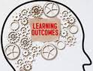
02
Learning Outcomes
Students will be able to:
understand the concept and structure on how to use unsupervised learnng other algorithms
Understand the implementation the k-means clustering algorithm
Understand the concept of the K-means optimization objective
Understand on how to choose the number of clusters for the k-means algorithm

Slide 5

03
References
1. Bishop, C. M. (2006). Pattern Recognition and Machine Learning. Springer.
2. Géron, A. (2019). Hands-On Machine Learning with Scikit-Learn, Keras, and TensorFlow. O'Reilly Media.
3. Murphy, K. P. (2012). Machine Learning: A Probabilistic Perspective. MIT Press.
4. Goodfellow, I., Bengio, Y., & Courville, A. (2016). Deep Learning. MIT Press.
5. Hastie, T., Tibshirani, R., & Friedman, J. (2009). The Elements of Statistical Learning: Data Mining, Inference, and Prediction. Springer.

Slide 6
Introduction to Unsupervised Learning
04

Slide 7
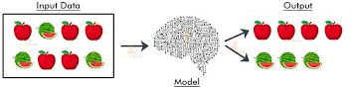
04
Unsupervised Learning Algorithms
Unsupervised Machine learning uses machine learning algorithms to analyse and cluster unlabelled datasets. These algorithms discover hidden patterns or data groupings without the need for human intervention.
Its ability to discover similarities and differences in information make it the ideal solution for exploratory data analysis, cross-selling strategies, customer segmentation and image recognition.
Clustering Algorithms eg K-Means clustering
Dimensionality Reduction Algorithms eg Principal Component Analysis (PCA)

Slide 8
Clustering
05

Slide 9
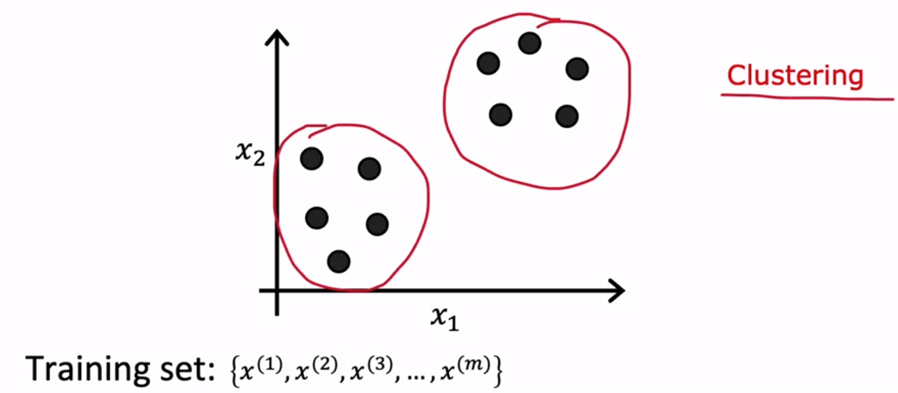
05
Clustering
What is Clustering?
Clustering algorithm is the first type f unsupervised machine learning algorithms to come across which looks at a number of data points and automatically finds data points that are related or similar to each other.

Slide 10
Clustering
05
Applications of Clustering
Grouping similar news
Market segmentation
Astronomical data analysis
DNA Analysis
etc

Slide 11
K-Means Intuition
06

Slide 12
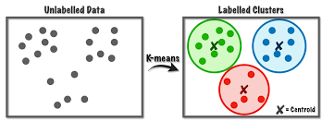
06
K-Means Clustering
Definition:
K-Means is an unsupervised machine learning algorithm used for clustering data points into k distinct groups based on similarities.
Clustering Objective:
The algorithm aims to minimize the within-cluster sum of squares, making the clusters as internally similar and compact as possible.

Slide 13
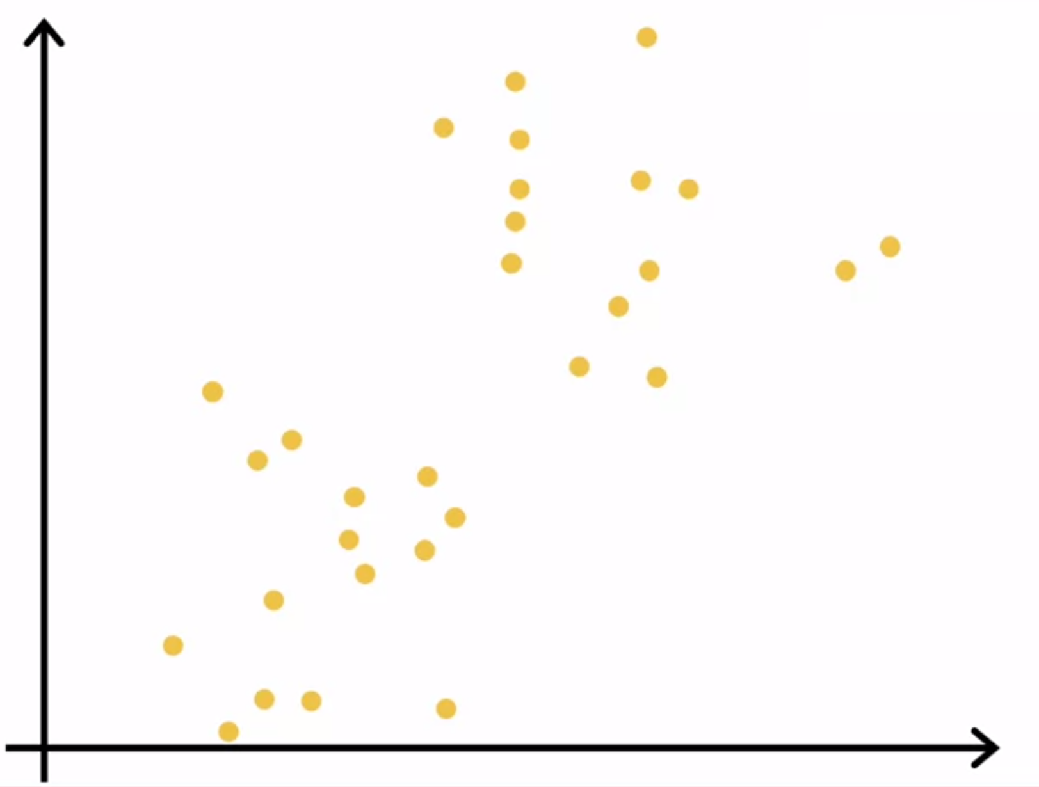
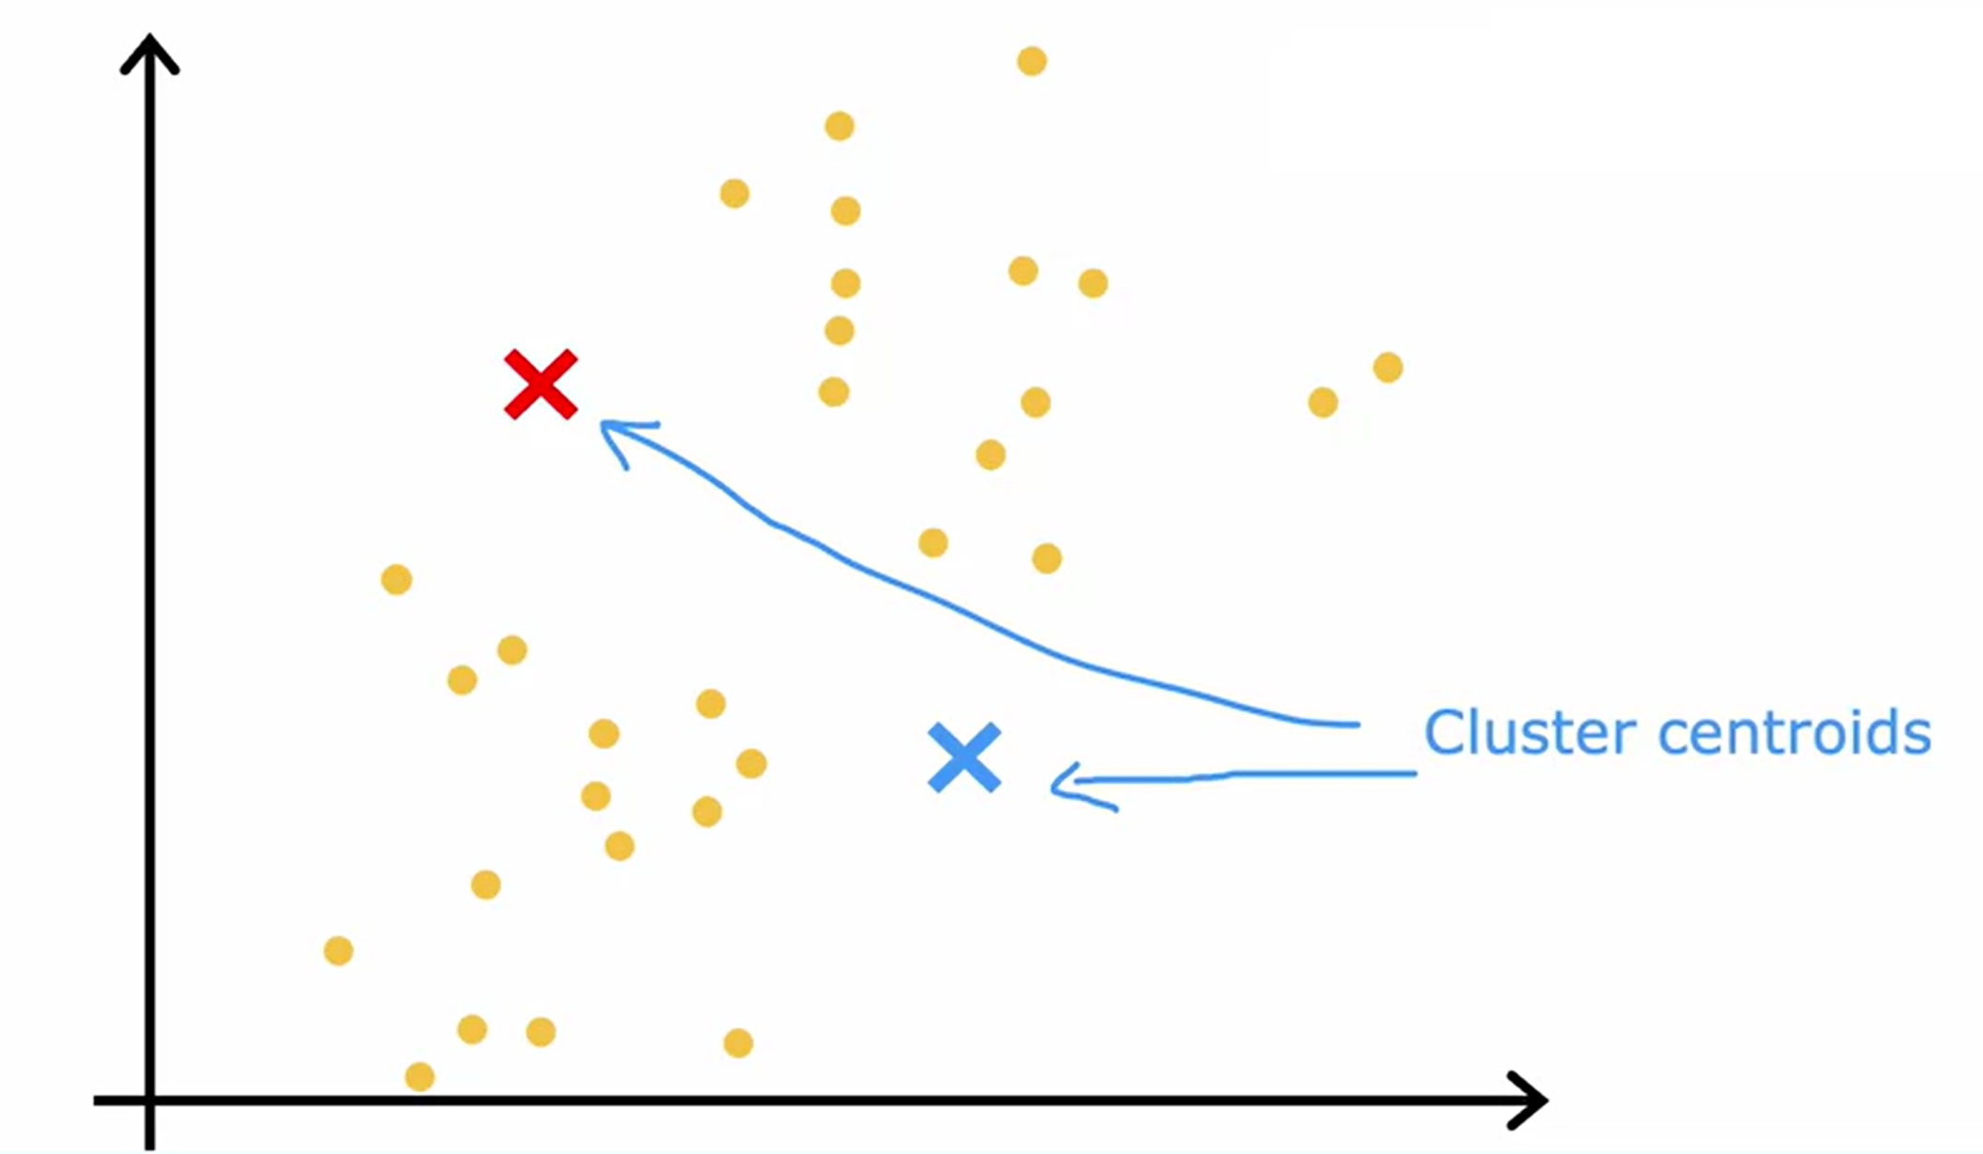
06
KMeans Intuition
To better understand how K-means cluster work, let consider 30 points.
The first thing that the K-means algorithm does is to take a random guess at where might be the centres of the two clusters that you might ask it to find. In this example I'm going to ask it to try to find two clusters (points), shown here as a red cross and the blue cross, at where might be the centres of two different clusters.
.

Slide 14
06
KMeans Intuition
Kindly note that KMeans repeatedly does two different things. The first is to assign points to cluster centroids and the second is to move the cluster centroids.
Immediately after the random guess of what are the centre of the cluster (cluster centroids), it will go through all of the 30 data points and take the two steps.
The first of the two steps is it will go through each of these points and look at whether it is closer to the red cluster centroid shown by the red cross or to the blue cluster centroid shown by the blue cross.
It will repeat it over and over again until every point is one of the cluster centroids.

Slide 15
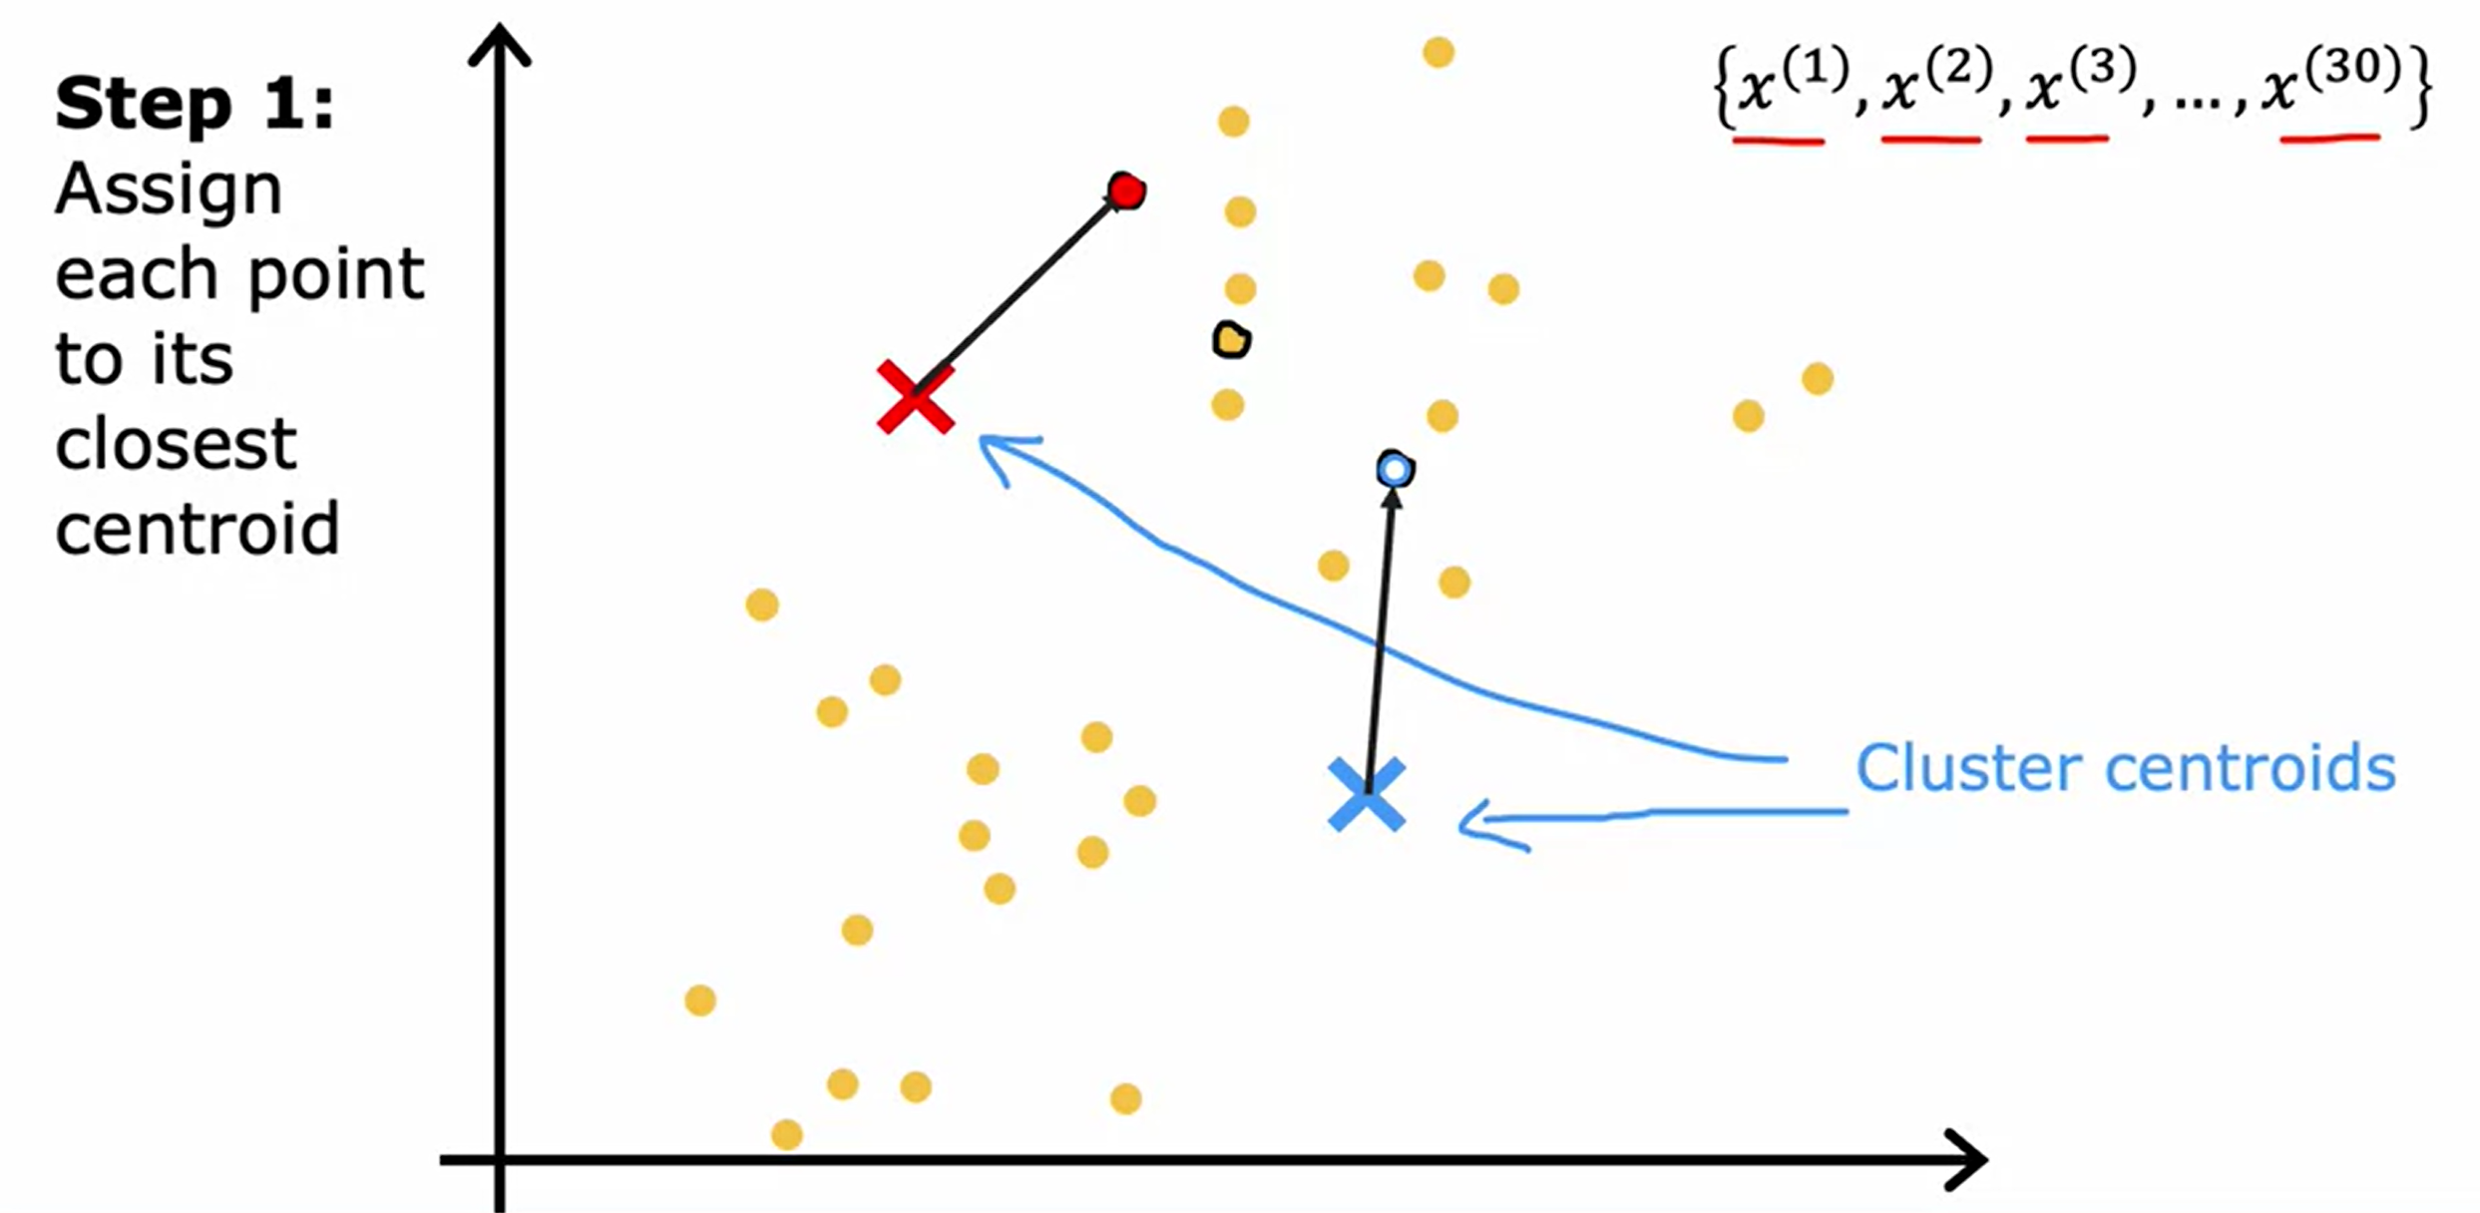
06
KMeans Intuition

Slide 16
06
KMeans Intuition
The second of the two steps that K-means does is, it'll look at all of the red points and take an average of them. Also, it will move the red cross to whatever is the average location of the red dots, which turns out to be the image as seen in the next side, so the red cluster centroid will move based on the average calculation.
Also, we do the same thing for all the blue dots. Look at all the blue dots, and take an average of them, and move the blue cross over there. So you now have a new location for the blue cluster centroid as well.

Slide 17
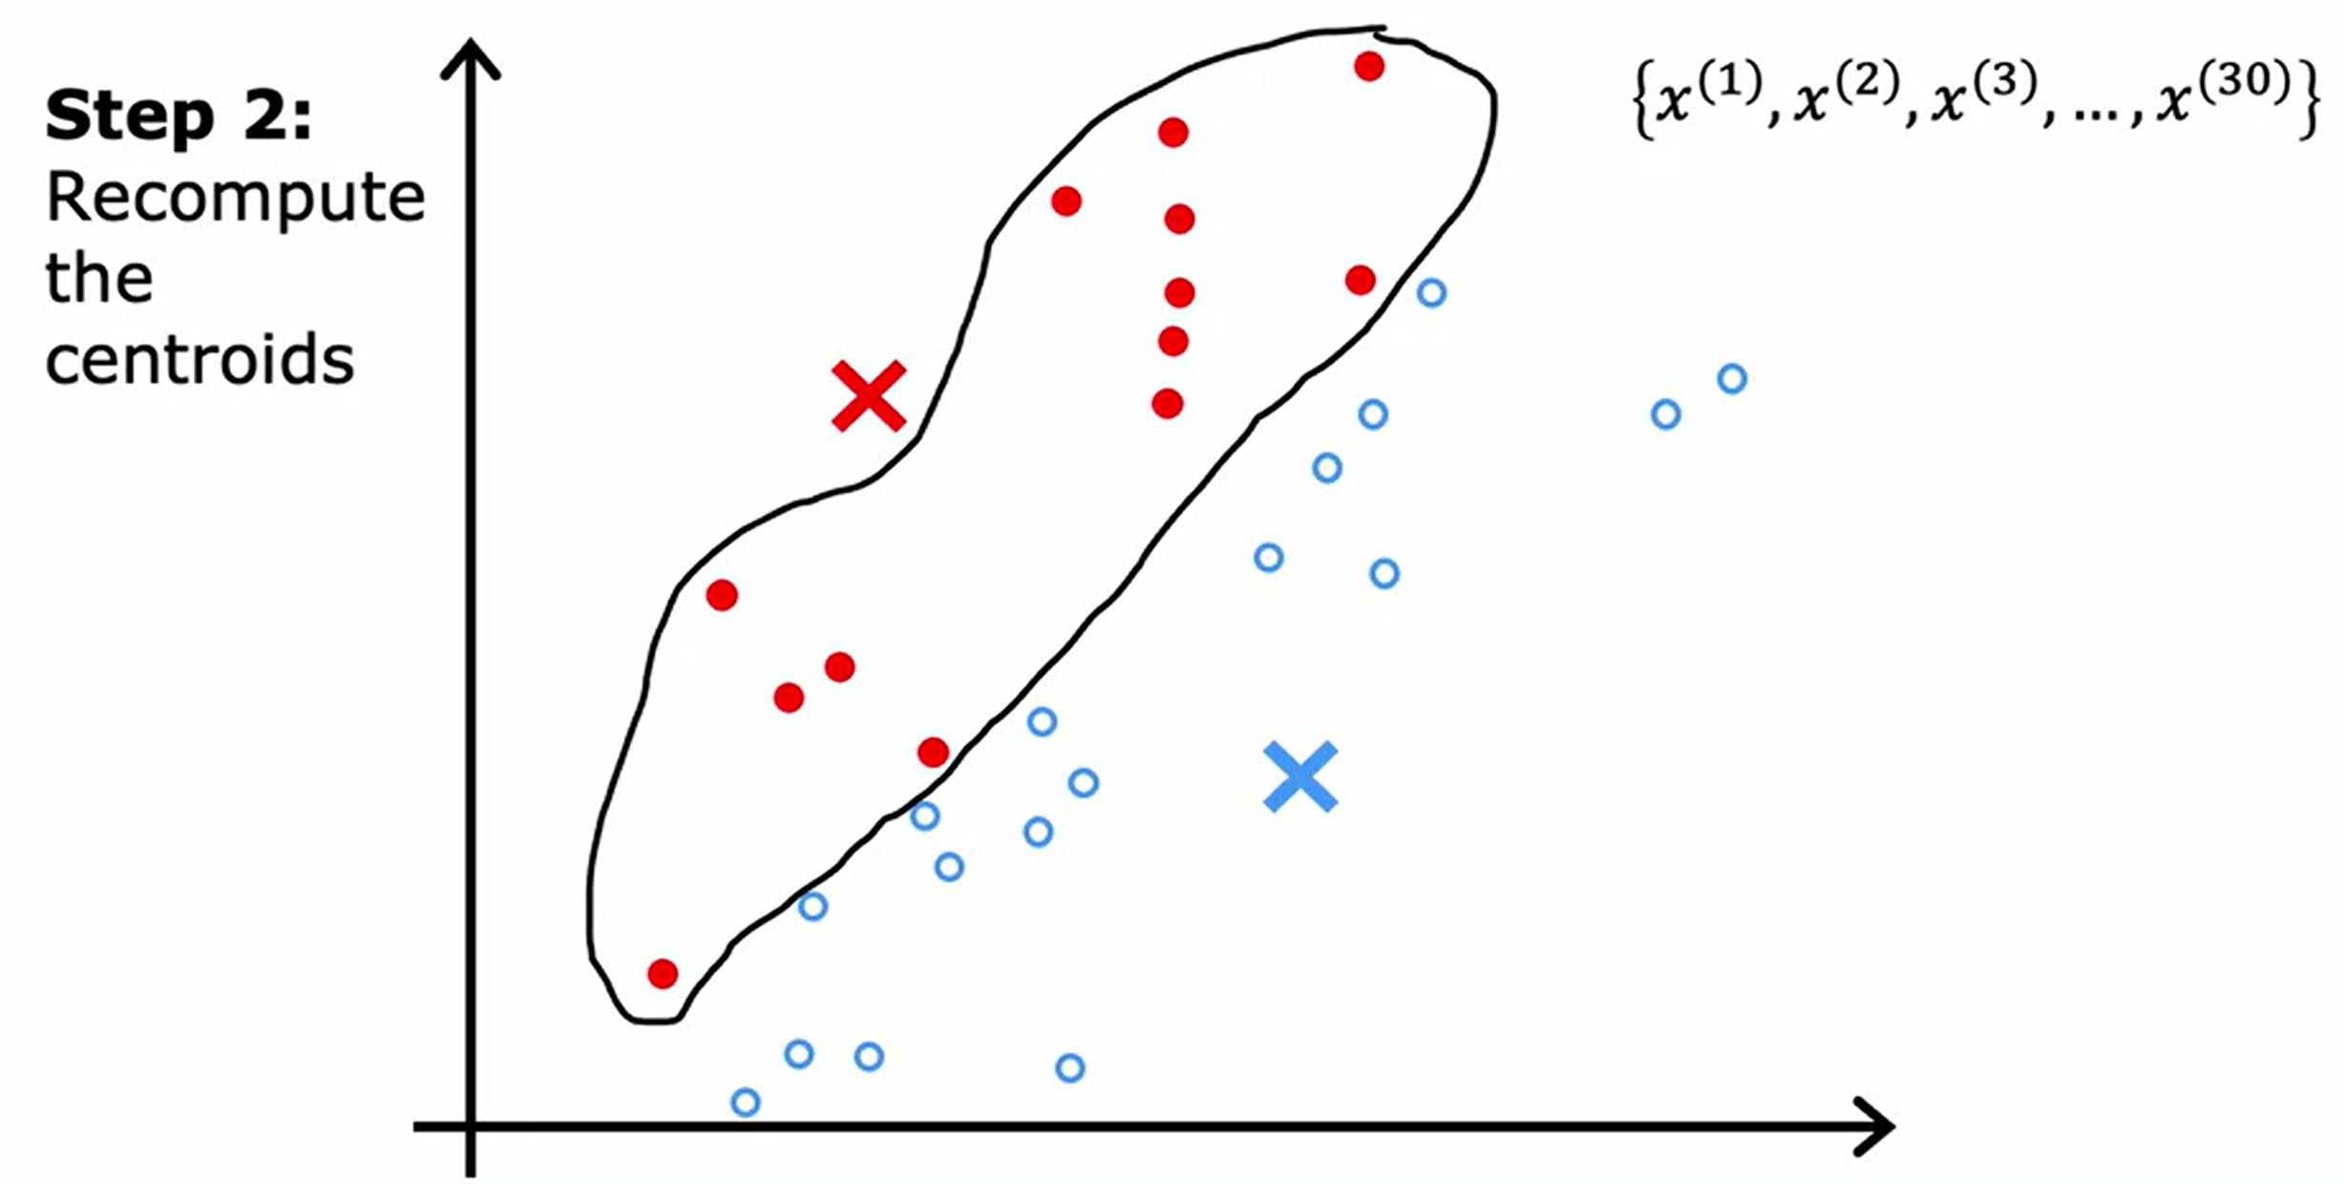
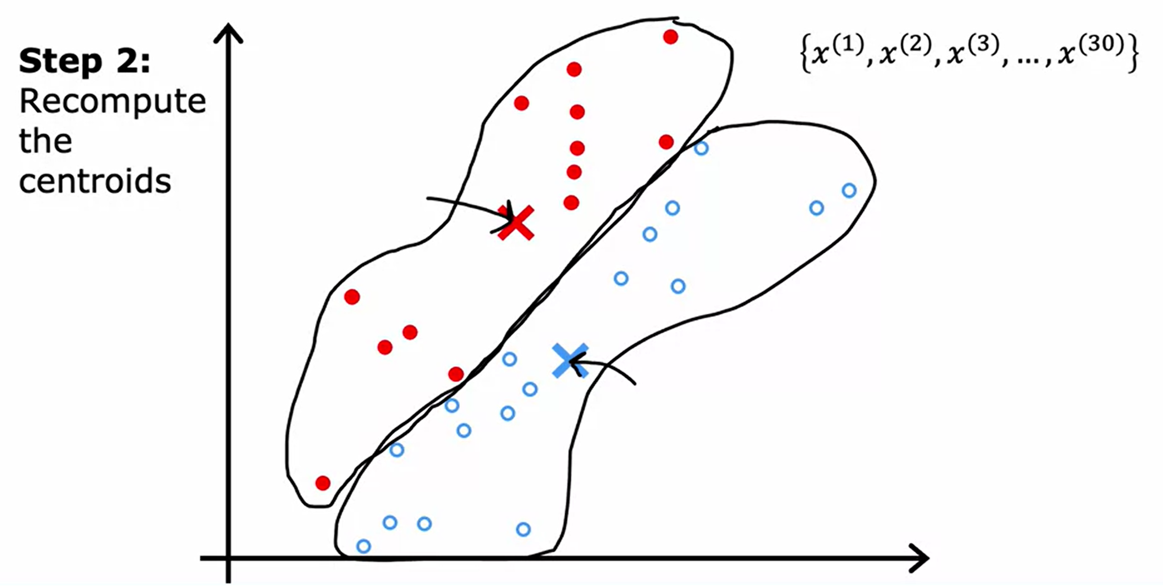
06
KMeans Intuition

Slide 18
06
KMeans Intuition
Then we just repeat the second part of K-means again which is to look at all of the red dots and compute the average.
Also look at all of the blue dots and compute the average location of all of the blue dots and it turns out that you end up moving the red cross over there and the blue cross over here.
Keep repeating the step all over again that is look at each point and assign it to the nearest cluster centroid and then also move each cluster centroid to the mean of all the points with the same colour.
If you keep on doing those two steps, you find that there are no more changes to the colours of the points or to the locations of the clusters centroids so this means that at this point the K-means clustering algorithm has converged.

Slide 19
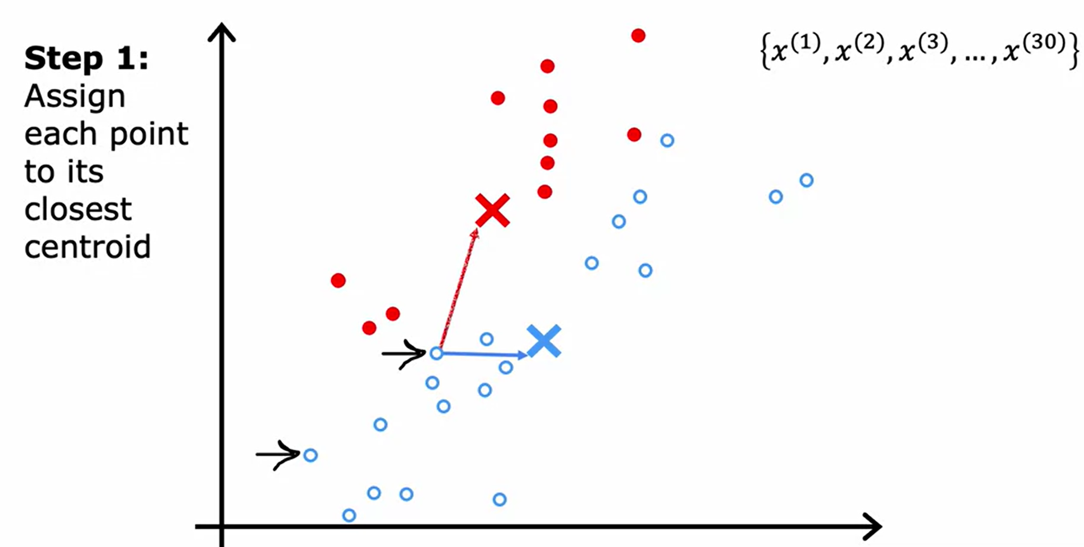
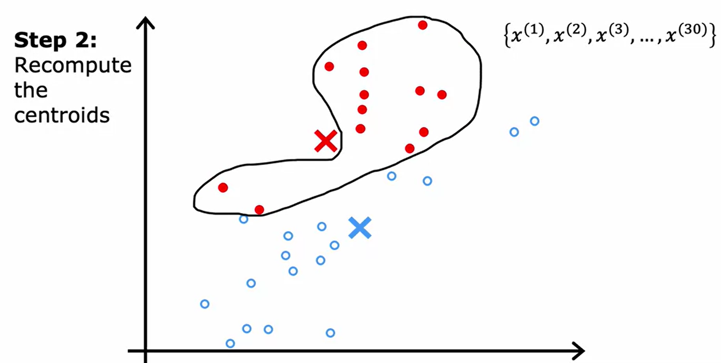
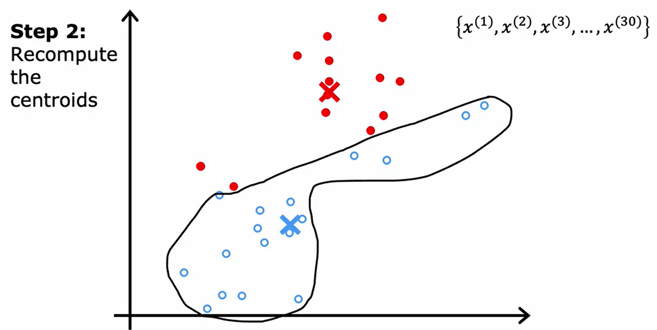
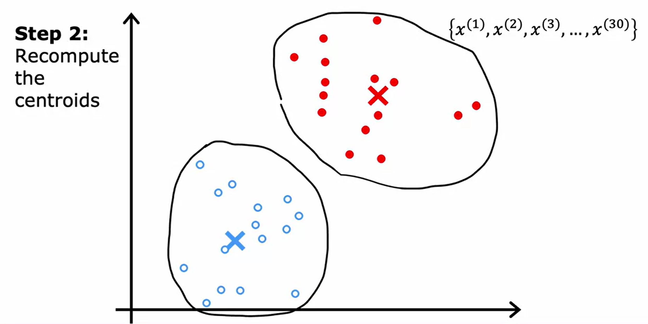
06
KMeans Intuition

Slide 20
K-Means Algorithm
07

Slide 21
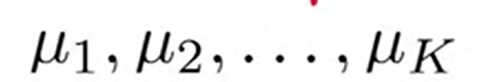
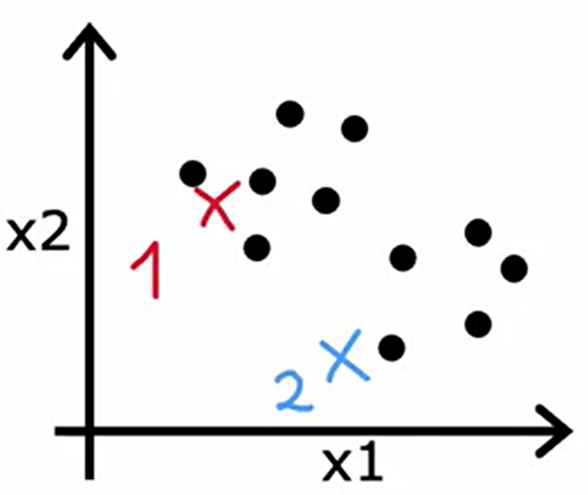
07
K-Means Algorithm
Randomly initialize K cluster centroids, Mu1, Mu2, through Mu k( )
Here K=2, so if the red cross was cluster centroid one then the blue cross will be cluster centroid two.
For simplicity, are vectors which have the same dimension (2-dimensional vectors) as the 30 training examples.
Having randomly initialized the K cluster centroids, K-means will then repeatedly carry out the two steps as mentioned previously.

Slide 22
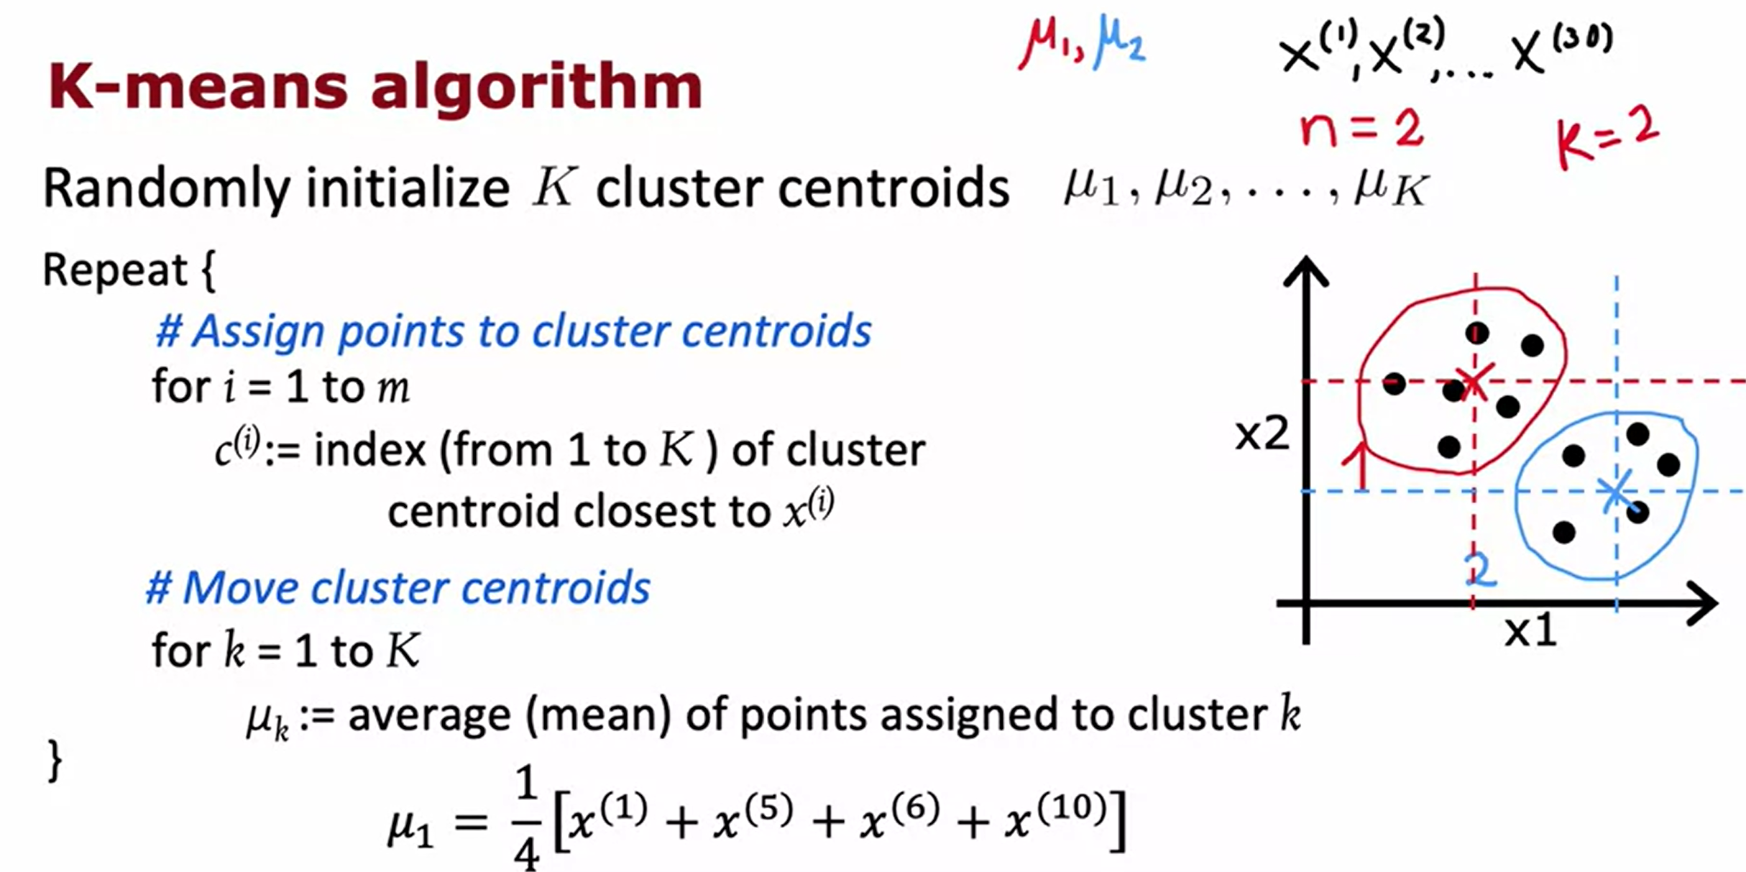
07
K-Means Algorithm

Slide 23
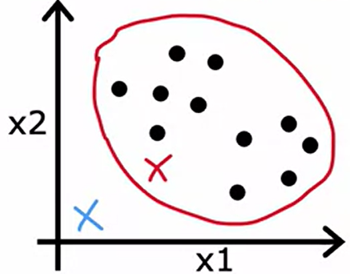
07
KMeans Algorithm
Question:
What happens if a cluster has zero training examples assigned to it?
Answer:
In case, it means it’s not well-defined. If that ever happens, the most common thing to do is to just eliminate that cluster. Therefore, ending with just 1 cluster.
Or if you really need, K clusters, an alternative would be to just randomly reinitialize that cluster centroid and hope that it gets assigned at least some points next time round.
However, it's actually more common when running K-means to just eliminate a cluster if no points are assigned to it.

Slide 24
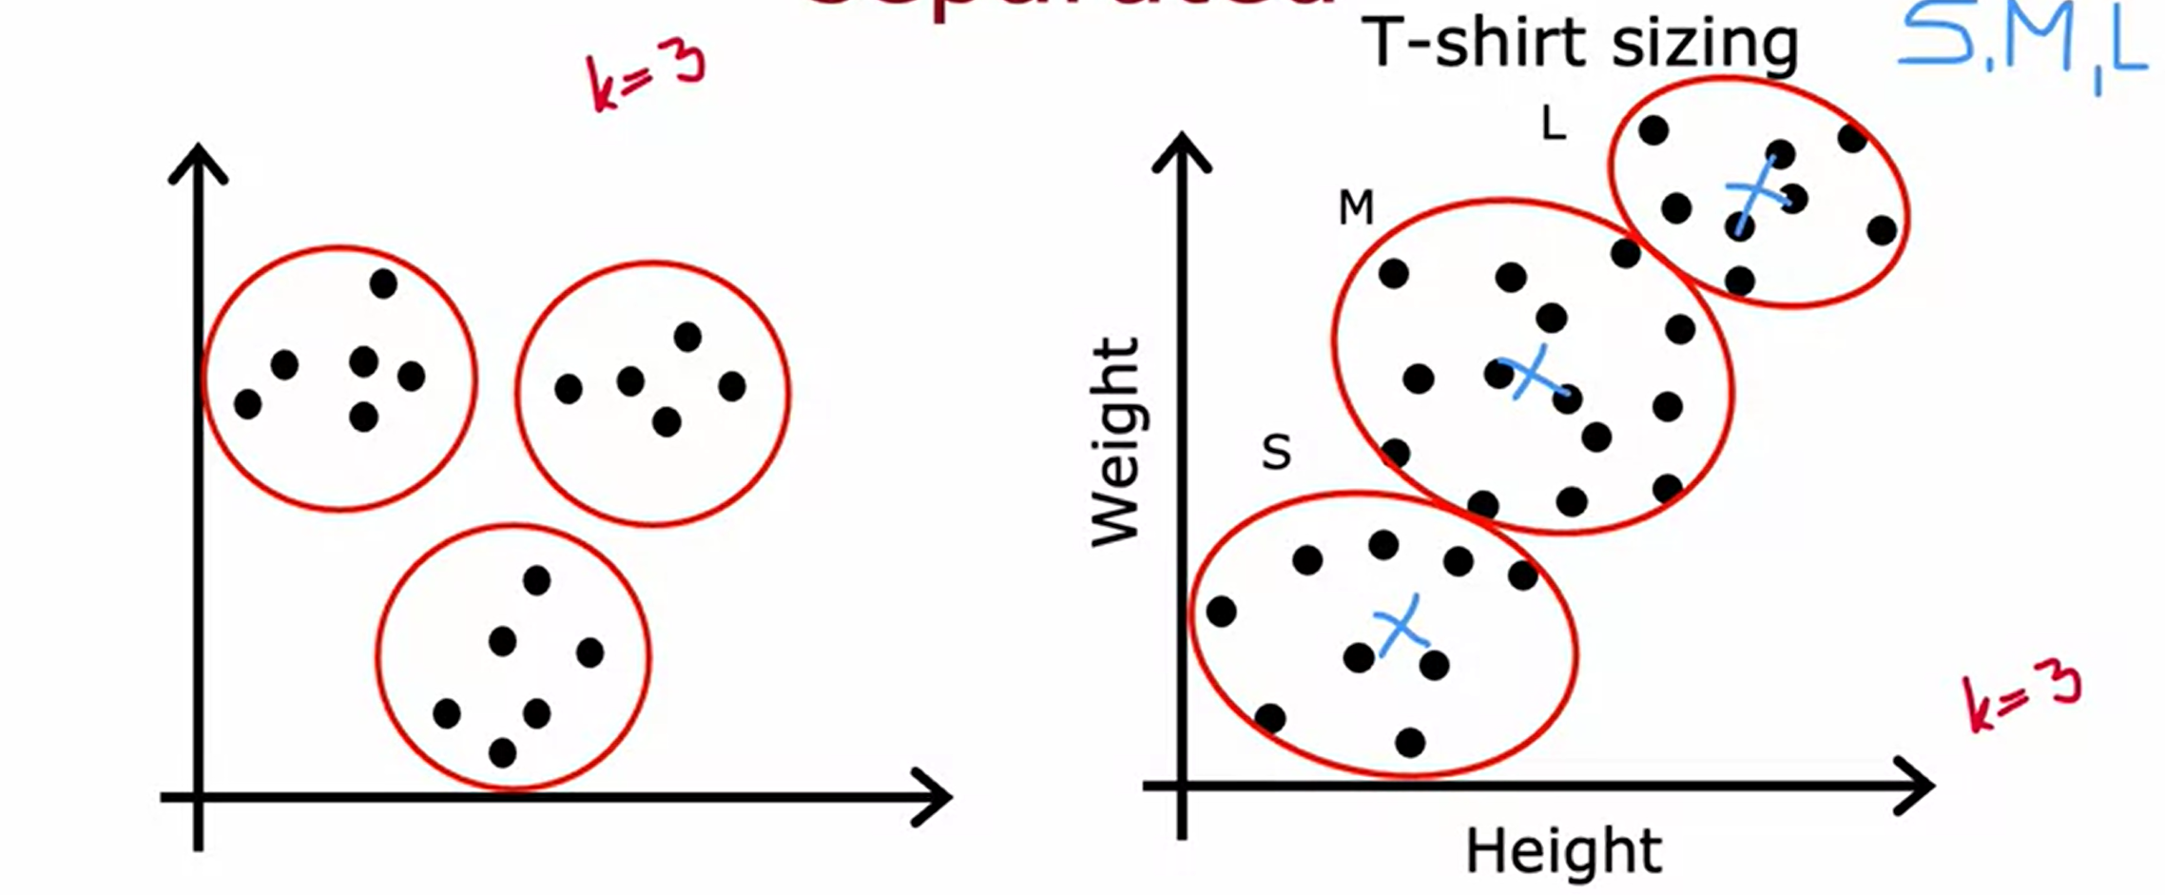
07
KMeans Clustering
K-means for clusters that are not well separated
K-means for clusters that are not well separated

Slide 25
K-Means Optimization Objective
08

Slide 26
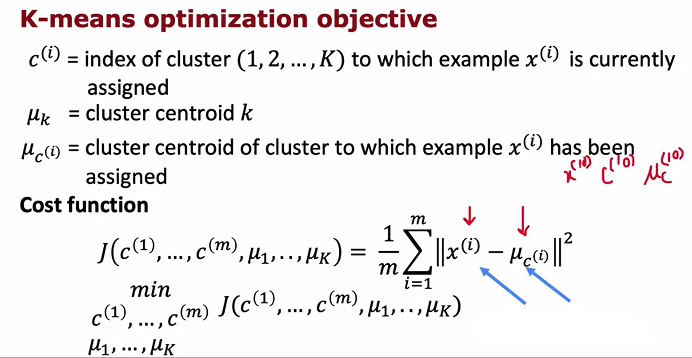
08
K-Means Optimization Objective

Slide 27
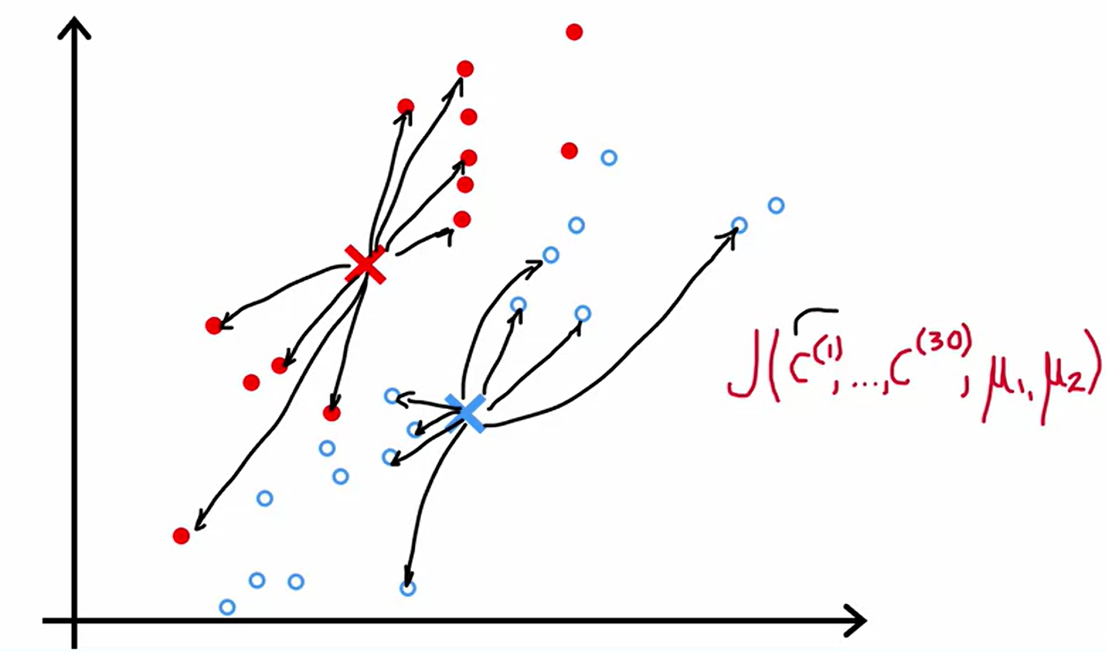
08
K-Means Optimization Objective

Slide 28
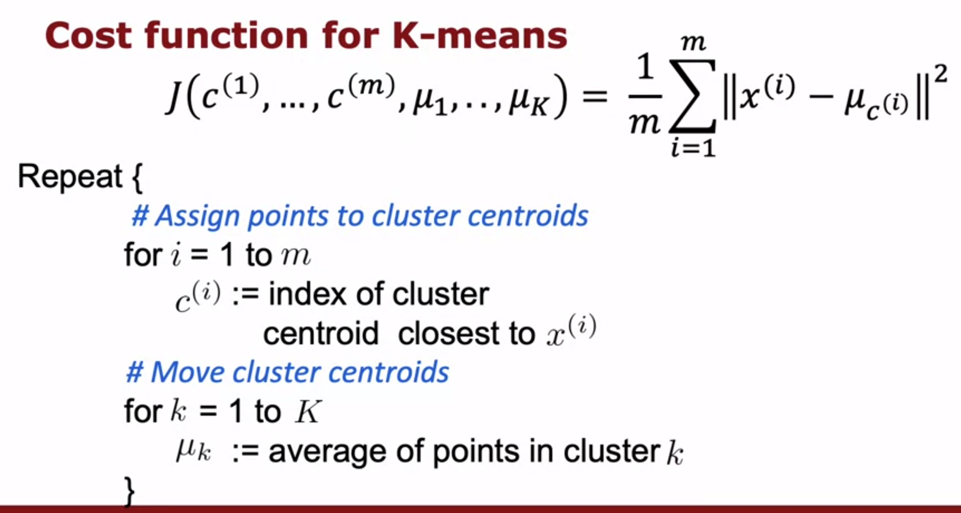
08
K-Means Optimization Objective

Slide 29
08
K-Means Optimization Objective
When running K means you should pretty much always choose the number of cluster centroids K to be lessened to training examples m. It doesn't really make sense to have K greater than m because then there won't even be enough training examples to have at least one training example per cluster centroids. So in our earlier example we had K equals two and m equals 30.

Slide 30
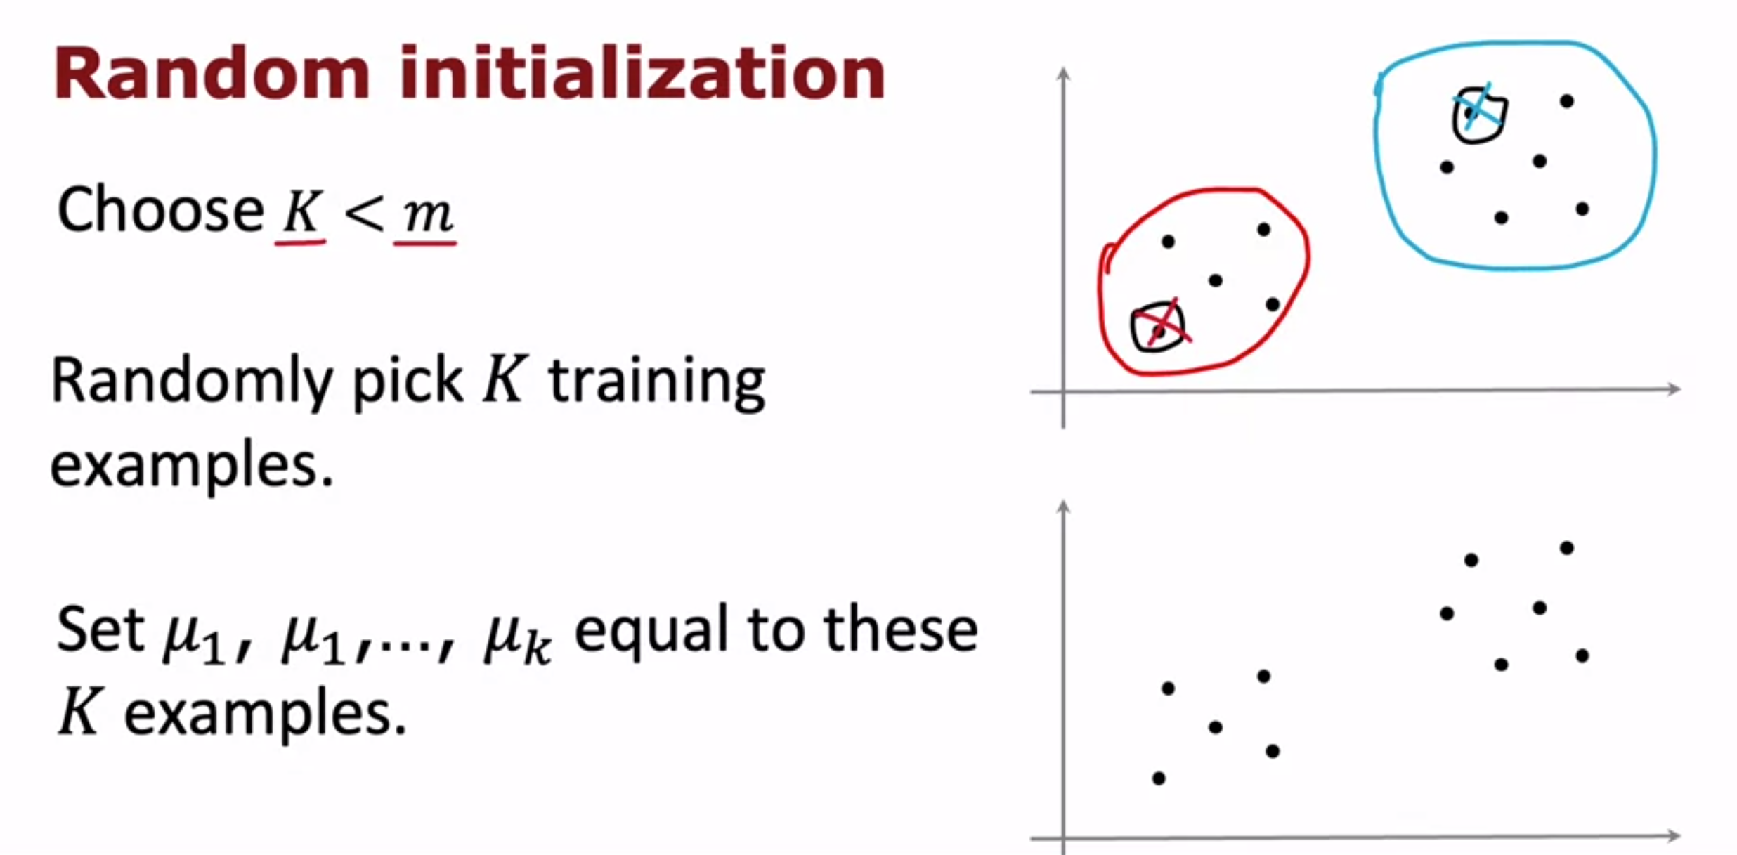
08
K-Means Optimization Objective

Slide 31
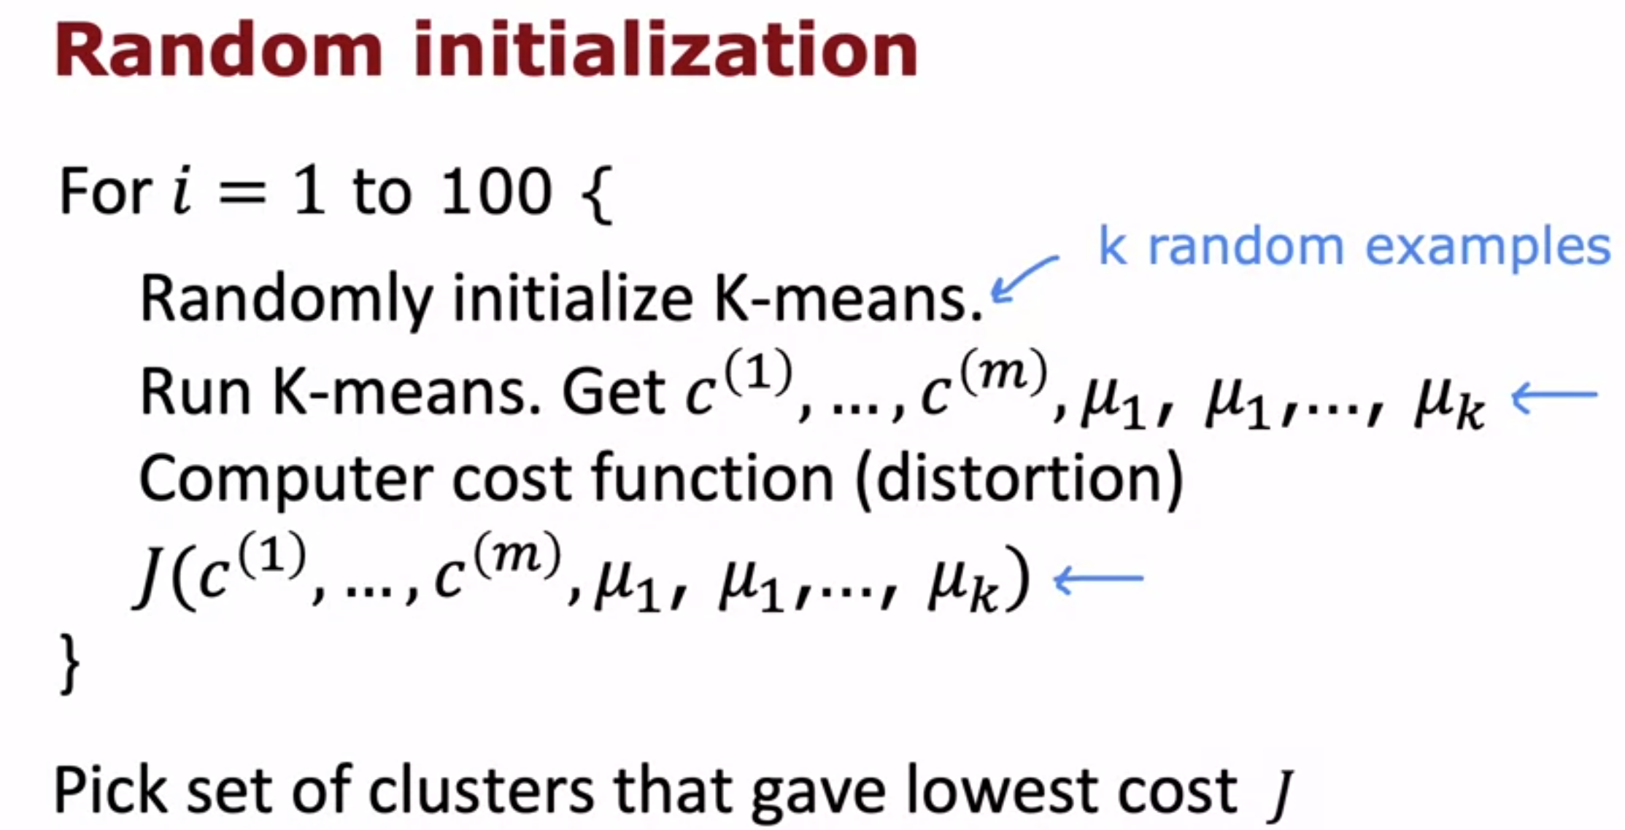
08
K-Means Optimization Objective

Slide 32
Choosing the number of clusters
09

Slide 33
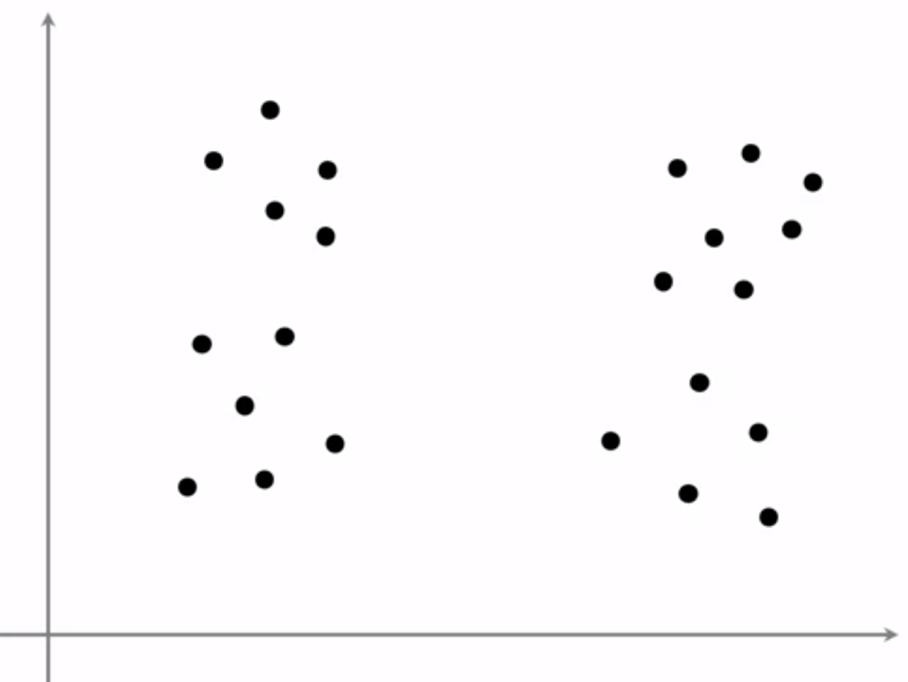
09
Choosing the number of cluster
How many clusters do you see?
If you say two or three or flour clusters. You are definitely right, because clustering is unsupervised learning algorithm you're not given the quote right answers in the form of specific labels to try to replicate.
Therefore, it believe to be ambiguous if this data has two or four, or maybe three clusters.

Slide 34
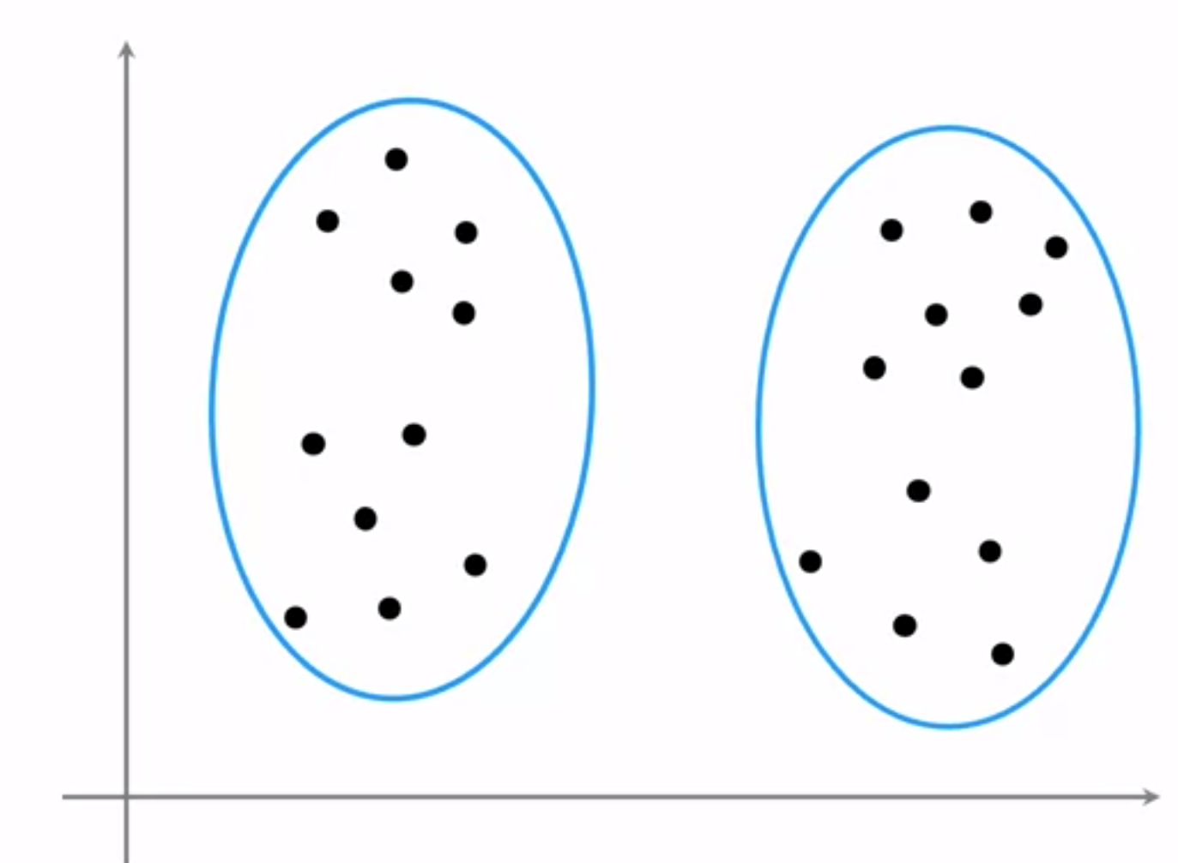
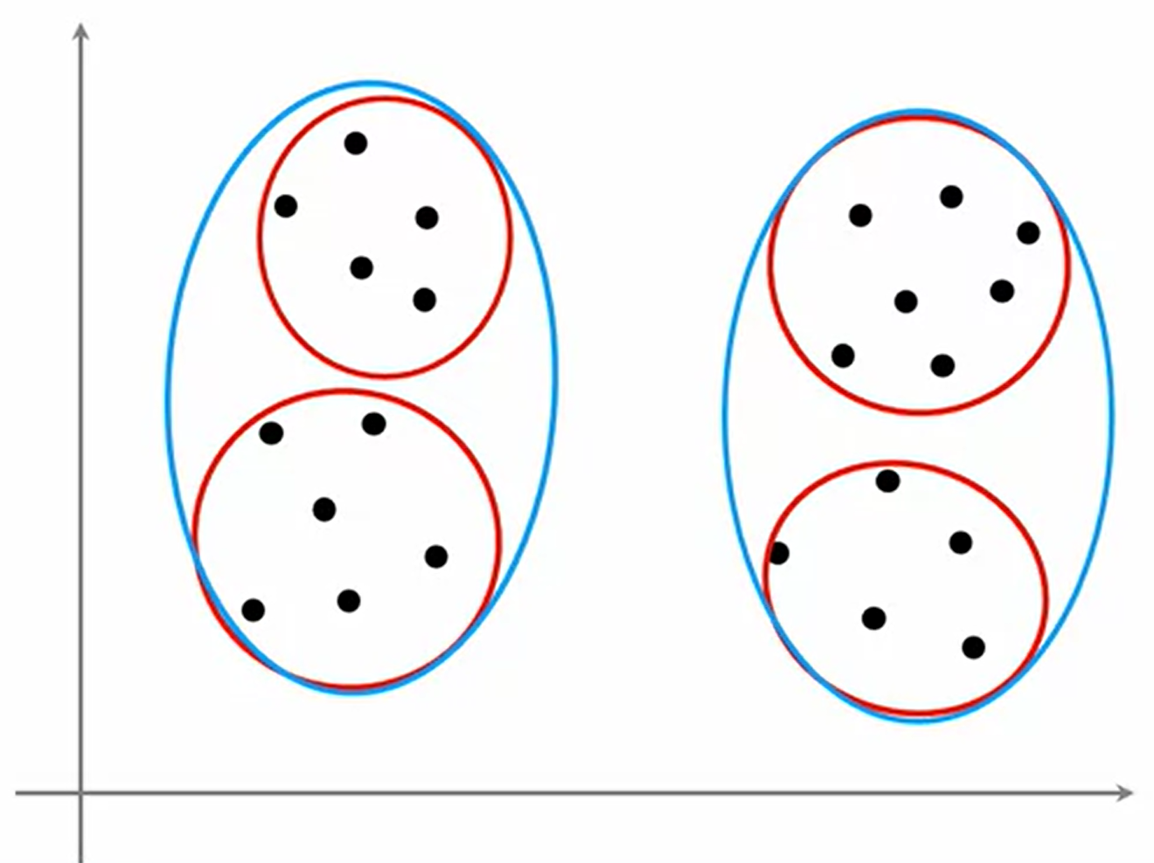
09
K-Means Optimization Objective

Slide 35
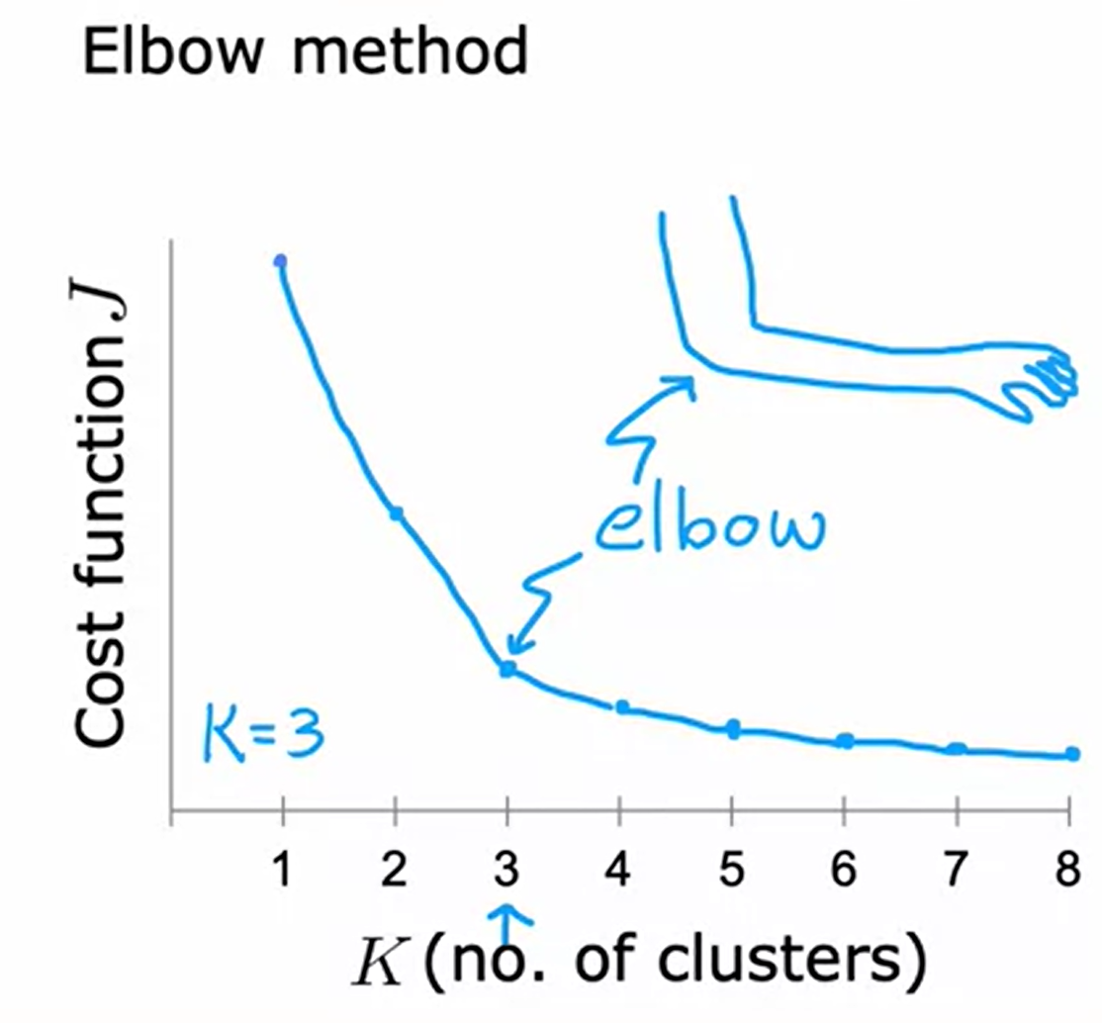
09
Choosing the number of cluster
One method of determining the number of cluster is called the elbow method.
How it work is that you run K-means with a variety of values of K and plot the cost function or the distortion function J as a function of the number of clusters.
What you noticed is that you’ll have very few clusters, say one cluster, the distortion function or the cost function J will be high and as you increase the number of clusters, it will go down, maybe as follows.
Then the curve will look like the image beside, where the cost function is decreasing rapidly until we get to three clusters but the decrease is more slowly after that.
Choosing K = 3 is applying the elbow method

Slide 36
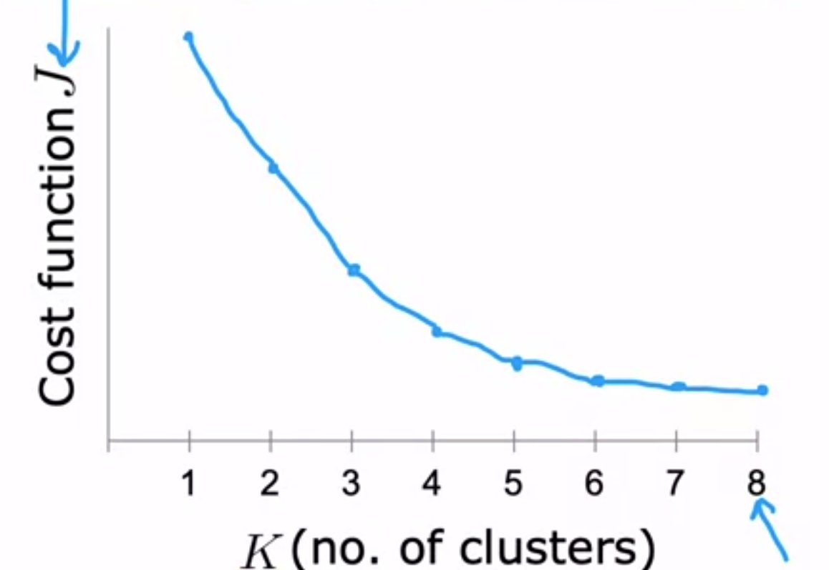
09
Choosing the number of cluster
However, choosing the right number of clusters could be ambiguous and you find that a lot of cost functions look like this with just decreases smoothly and it doesn't have a clear elbow by wish you could use to pick the value of K.
Therefore, choosing K just to minimize the cost function is not a good technique.

Slide 37
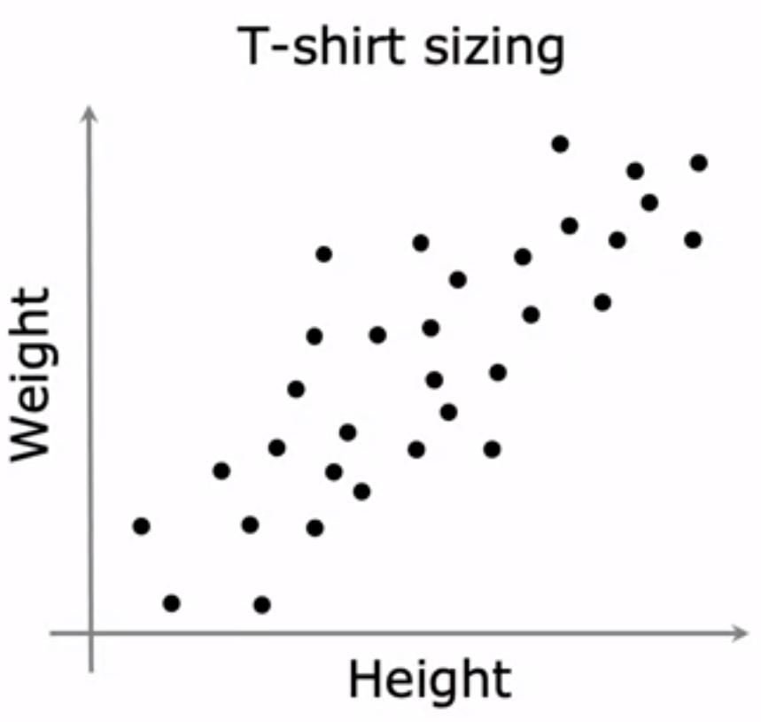
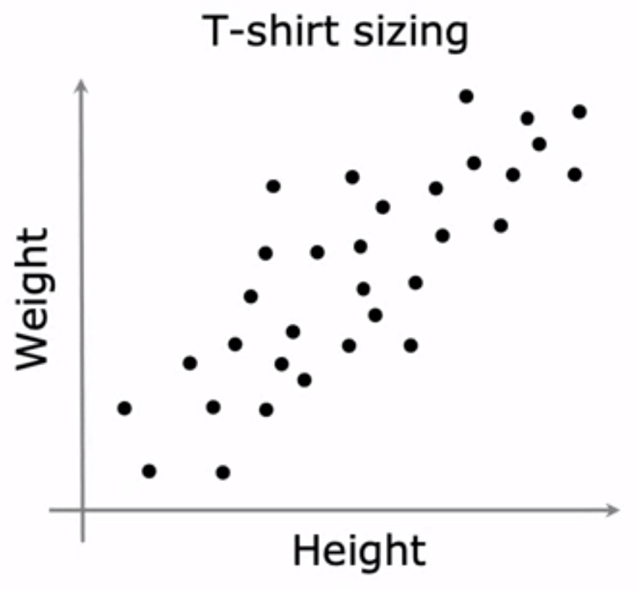
09
Choosing the value of K
Therefore, if you want to get clusters for some purpose, evaluate K-means based on how well it performs on that purpose. For example, clustering the T-shirt sizes for a manufacturer could go this way below.

Slide 38
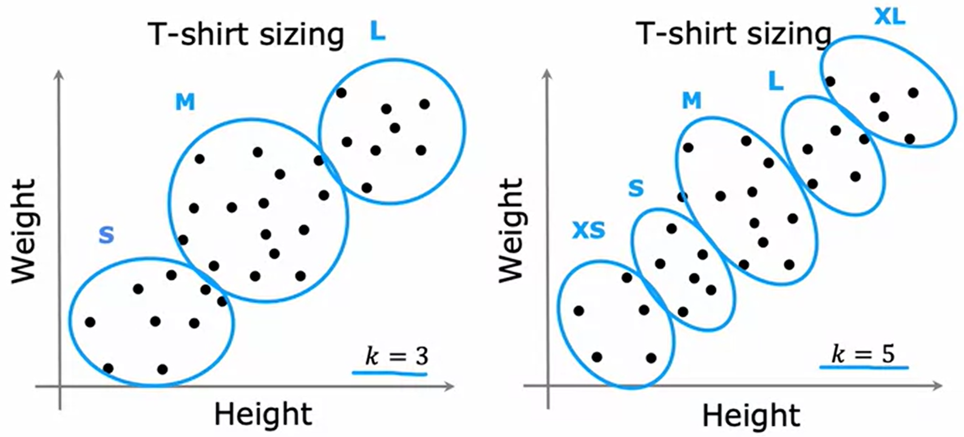
09
Choosing the value of K

Slide 39
10
Summary of K-Means Clustering
How K-Means Works
Random Initialization: K centroids are randomly placed in the feature space.
Assignment Step: Each data point is assigned to the nearest centroid, creating k clusters.
Update Step: The centroids are recalculated as the mean of the data points in each cluster.
Iteration: The assignment and update steps are repeated until convergence (centroids stop moving significantly).

Slide 40
K-Means Clustering
05
Choosing the Number of Clusters (k)
Elbow Method: Plotting the within-cluster sum of squares against different values of k and selecting the "elbow" point where the improvement saturates.
Silhouette Score: Evaluating the quality of clusters based on cohesion and separation.
Advantages and Disadvantages of K-Means
Advantages: Simple, fast, and efficient for large datasets; suitable for spherical clusters.
Disadvantages: Sensitive to initial centroids; may converge to local optima; not suitable for non-spherical or overlapping clusters.

Slide 41
In this practical session, we performed the following steps:
1. Imported necessary libraries.
2. Loaded and explored the dataset.
3. Preprocessed the data by separating features and target variable, and splitting it into training and testing sets.
4. Built and trained a Decision Tree model with a specified maximum depth.
5. Made predictions on the test set and evaluated the model's performance using accuracy and a classification report.
6. Optionally, visualized the Decision Tree using graphviz for better understanding.
Note: Make sure to have the required dataset ('heart.csv') and install necessary libraries (e.g., scikit-learn, pandas, graphviz) before running the code.
Seminar- K-Means Clustering
05
In this practical session, we performed the following steps:
Imported necessary libraries.
Loaded and explored random dataset.
Preprocessed the data by selecting relevant features for clustering.
Built and trained the K-Means model with k=3.
Visualized the clusters along with their centroids to interpret the results.
Open the

Slide 42
Thanks for Listening

